Slide 1
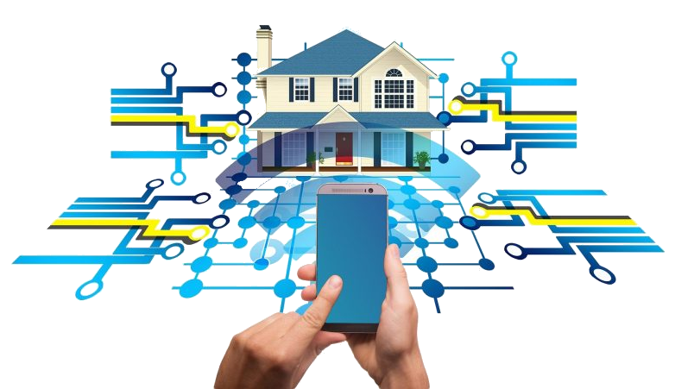
DIY Integration i HA
Gennemgang af hvordan du får forbindelse til Home Assistens

Slide 2

Udviklingsplatform
Hardware
MQTT
Kode eksempel 1
Kode eksempel 2

Slide 3

Platform
Arduino
PlatformIO
Opsætning
Gennemgang
Connect to target
Notes:
VM mashine installation
VS extension
Where is everything build upload…

Slide 4
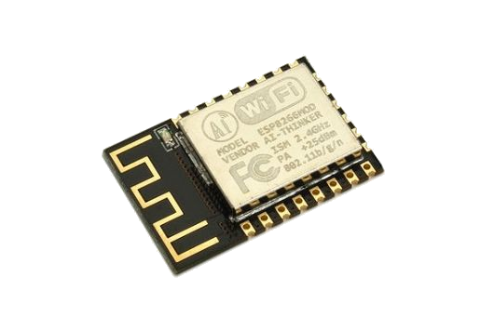
Hardware
Hvad kan vi bruge af hardware
Fordele/Ulemper
Notes:
ESP32 vs ESP8266

Slide 5

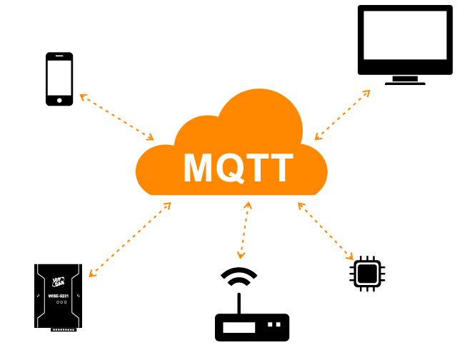
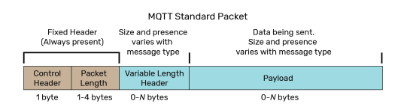
Hvad er MQTT
Historie
Pub/Sub
QoS
Eksempel
Debug med TT3 (https://github.com/francoisvdm/TT3)
Notes:
Designed for industrial networks. In the 1990 of what now is Philips
Low-bandwidth dial-up and satellite SCDA infrastructure
Traditional poll response Master is update when req new data / report-by-exception.
Flexible topic paths
QoS 0 publishes a message once with no required acknowledgment.
QoS 1 publishes a message repeatedly until it is acknowledged.
QoS 2 publishes a message repeatedly but guarantees that it is received only once
Decoupled data
MQTT TLS

Slide 6
Kode eksemple 1
Connect to wifi
JSON
https://github.com/IDASeminar/HomeAutomation/tree/main/ESP-12E%20connect

Slide 7
Kode eksemple 2
Hvorfor bruge et færdigt bibliotek
https://github.com/dawidchyrzynski/arduino-home-assistant
https://githhttps://github.com/IDASeminar/HomeAutomation/tree/main/HomeAssistensIntegration

